Slide 1
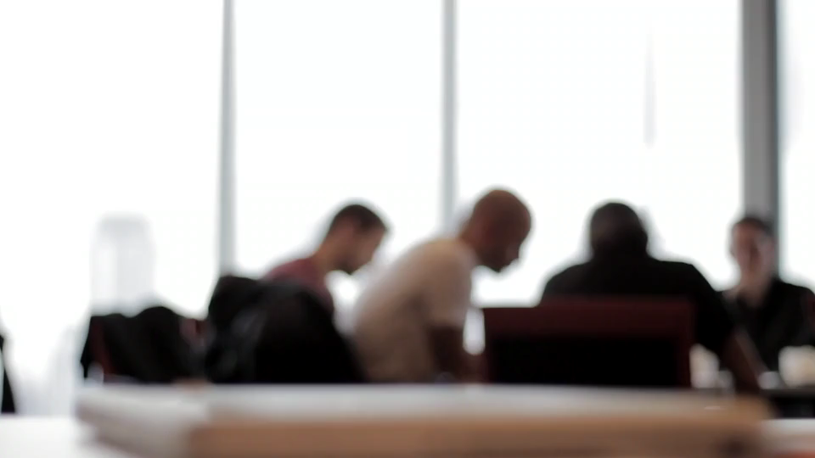
職場故事 (Animaze)
Notes:
https://pixabay.com/videos/discussion-desk-people-office-team-8252/

Slide 2

1.目標
Notes:
https://pixabay.com/videos/codes-internet-computer-code-23355/

Slide 3

2. 阻礙
Notes:
https://pixabay.com/videos/work-office-people-working-87593/

Slide 4

3. 努力

Slide 5
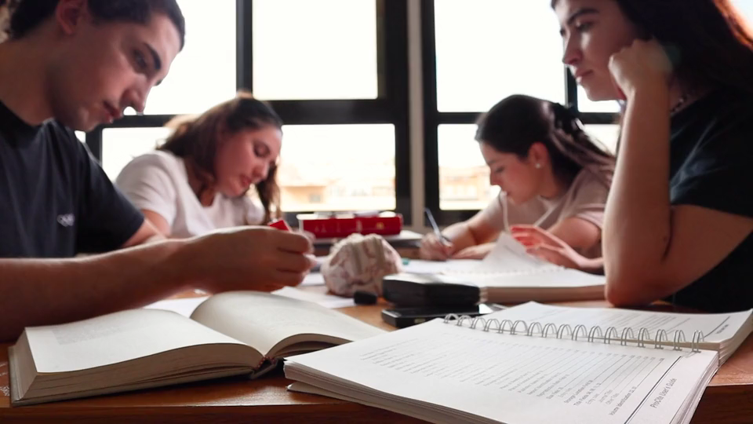
4. 結果
Notes:
https://pixabay.com/videos/students-books-papers-text-study-159029/

Slide 6

5. 意外
Notes:
https://pixabay.com/videos/code-programming-system-failure-14214/

Slide 7

6. 轉彎
Notes:
https://pixabay.com/videos/laptop-hands-programming-work-52823/

Slide 8
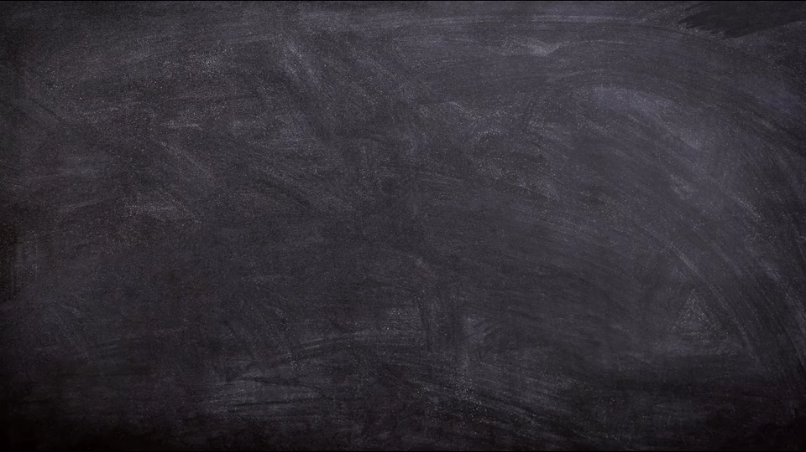
7.結局
Notes:
https://pixabay.com/videos/board-chalk-feedback-review-study-18398/

